Slide 1
Normal Data or Skewed Data?

Slide 2
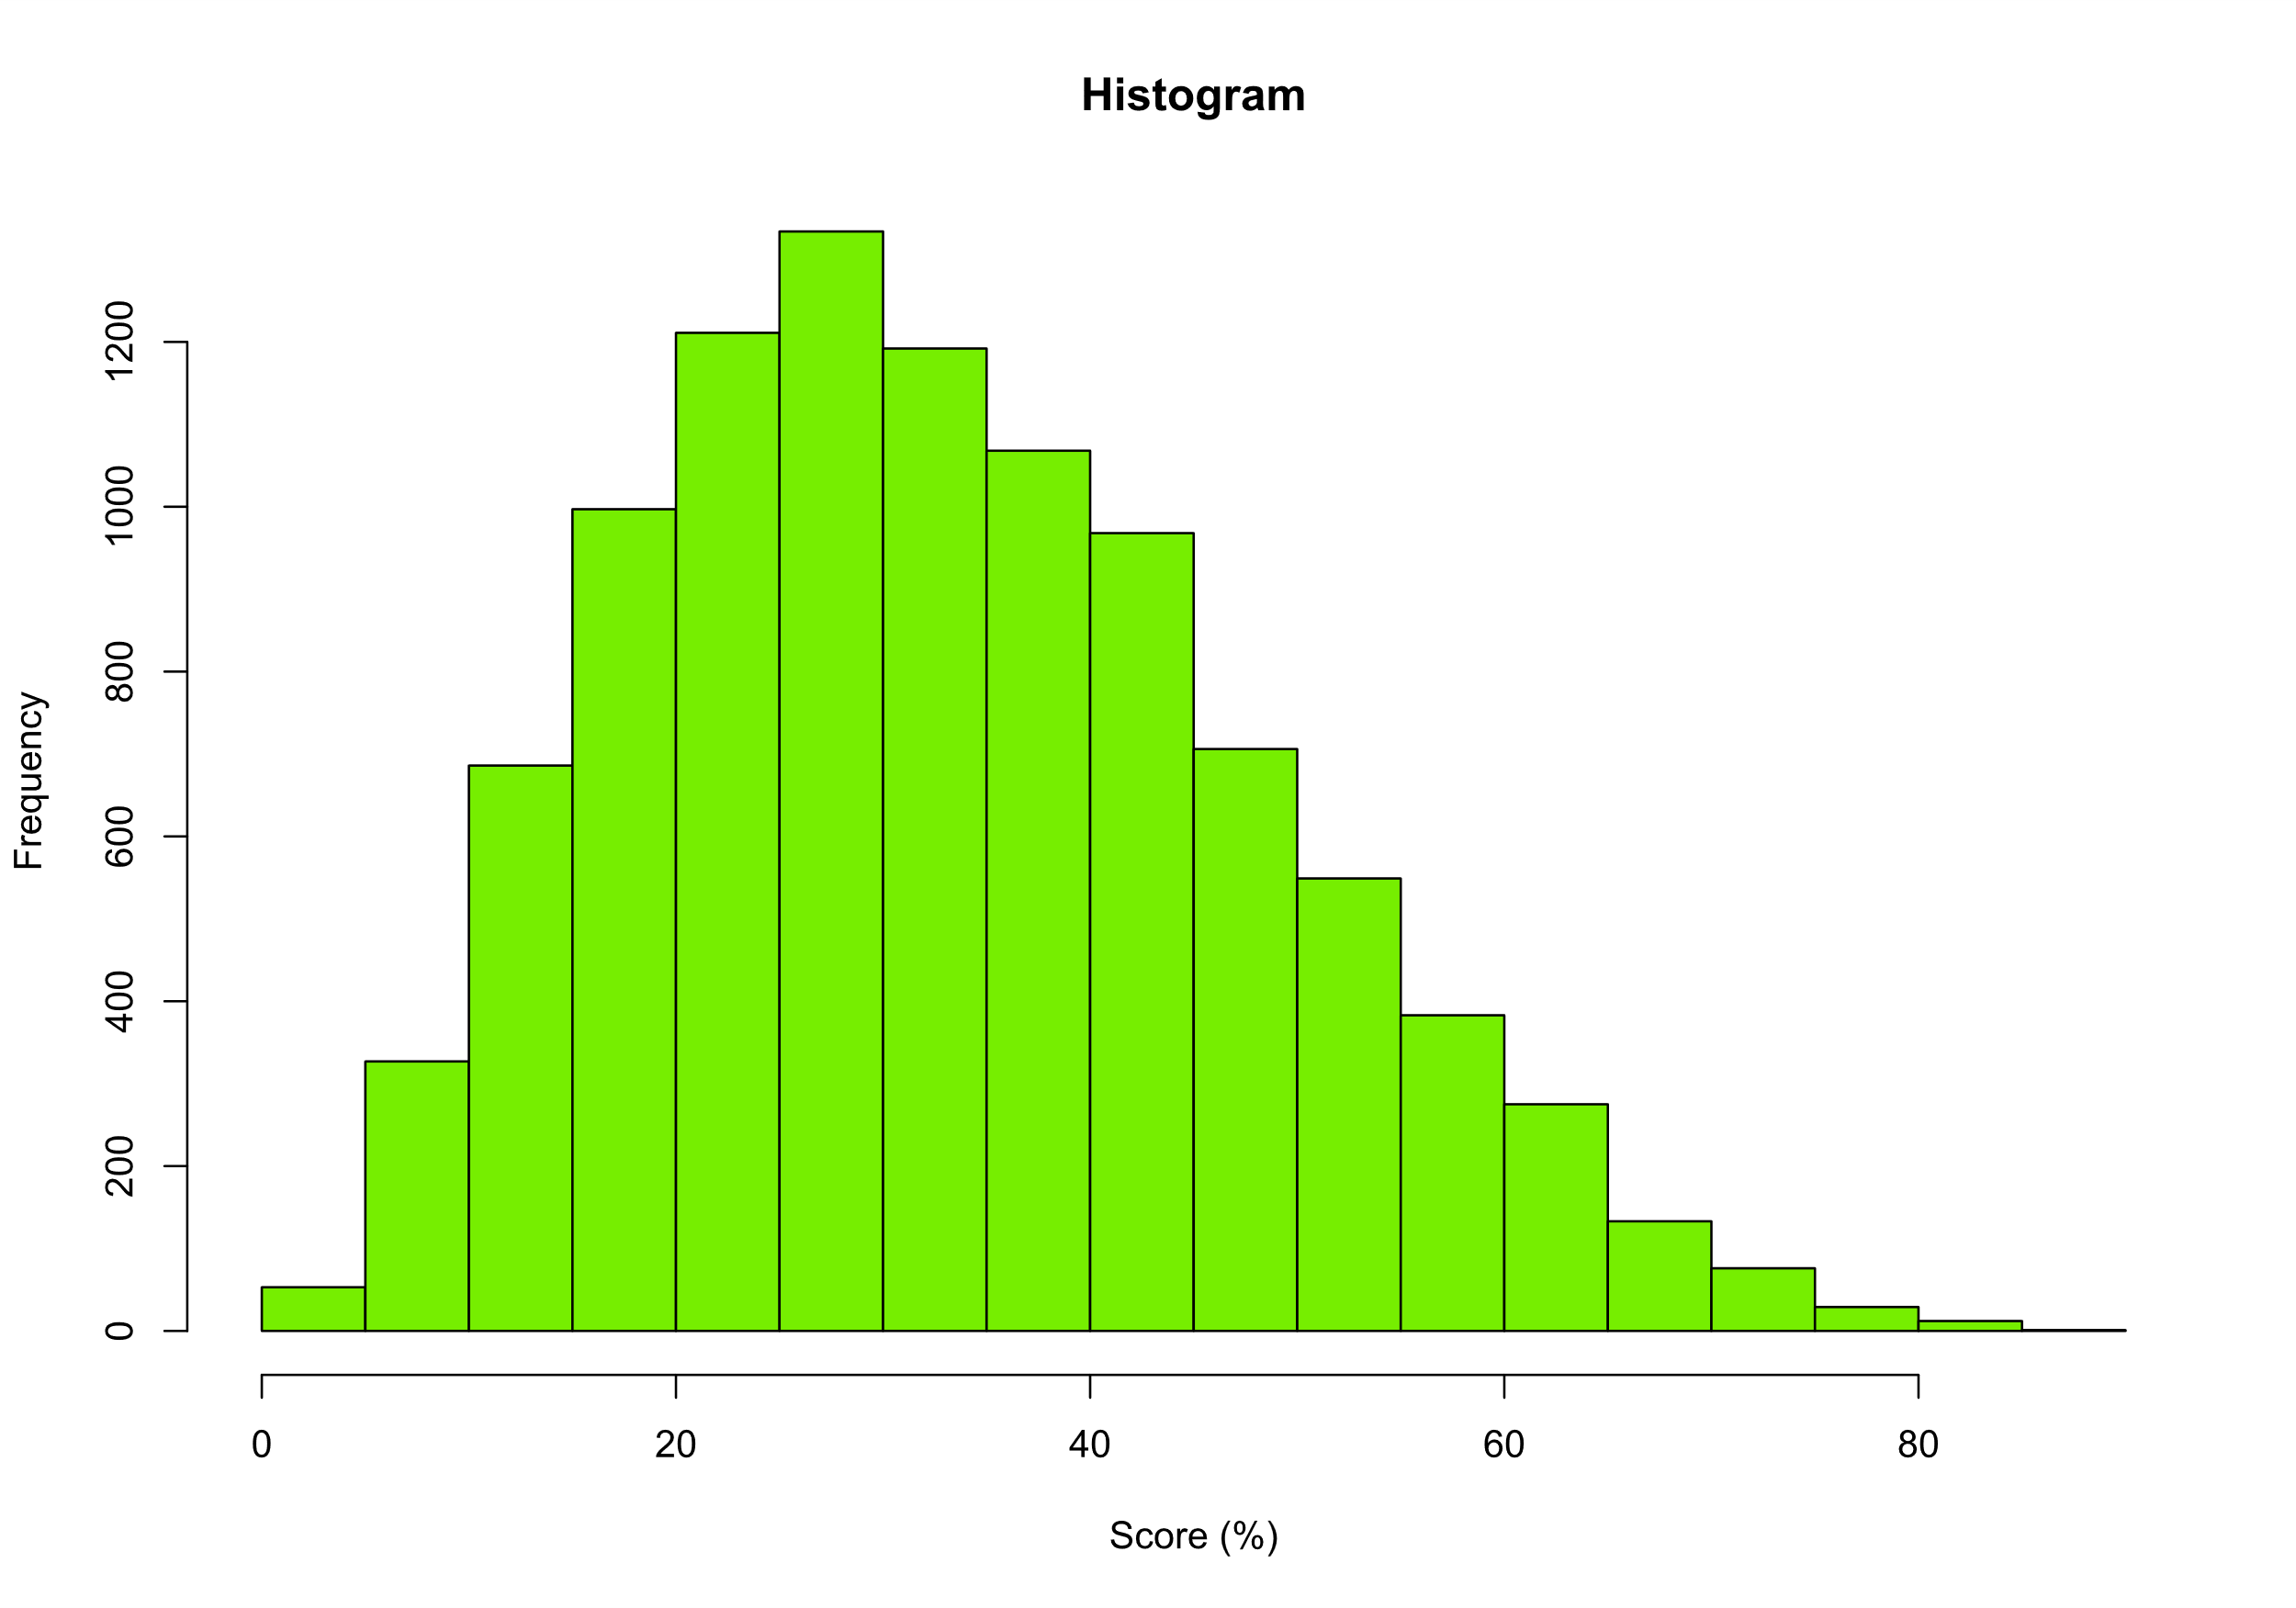
Normal
Skewed- Left Tail
Skewed- Right Tail

Slide 3
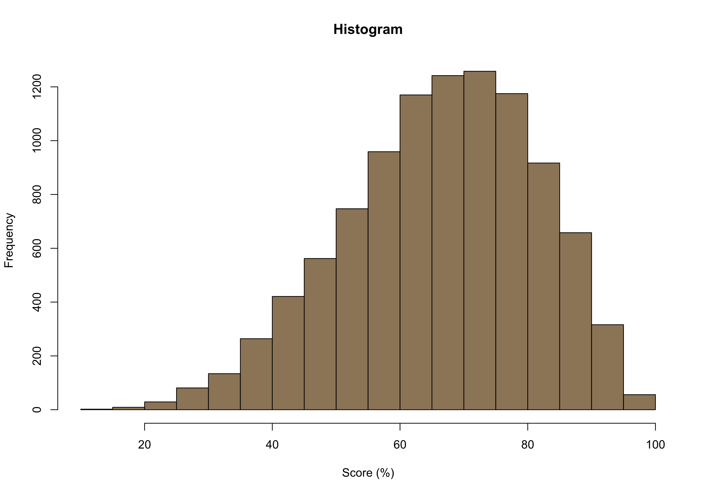
Normal
Skewed- Left Tail
Skewed- Right Tail

Slide 4
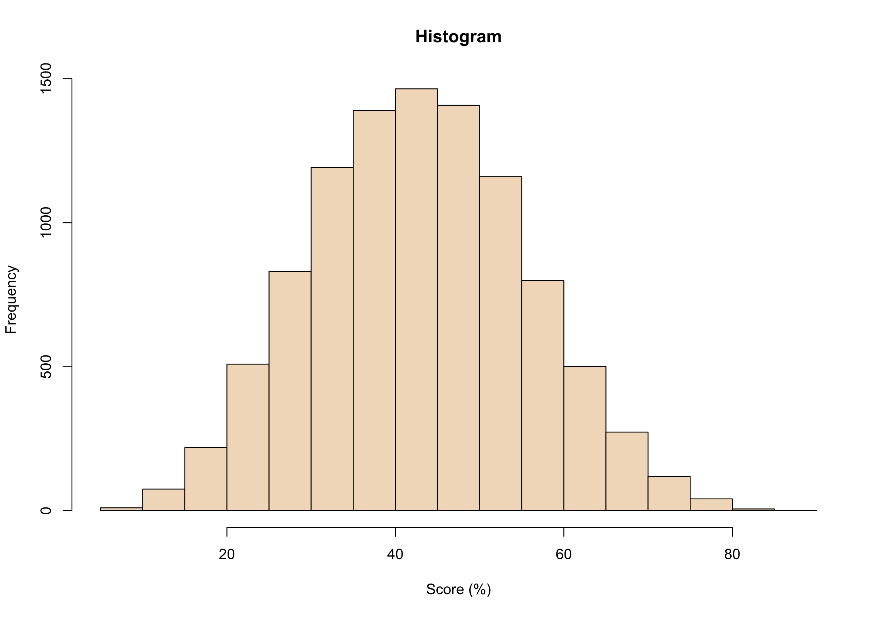
Normal
Skewed- Left Tail
Skewed- Right Tail

Slide 5
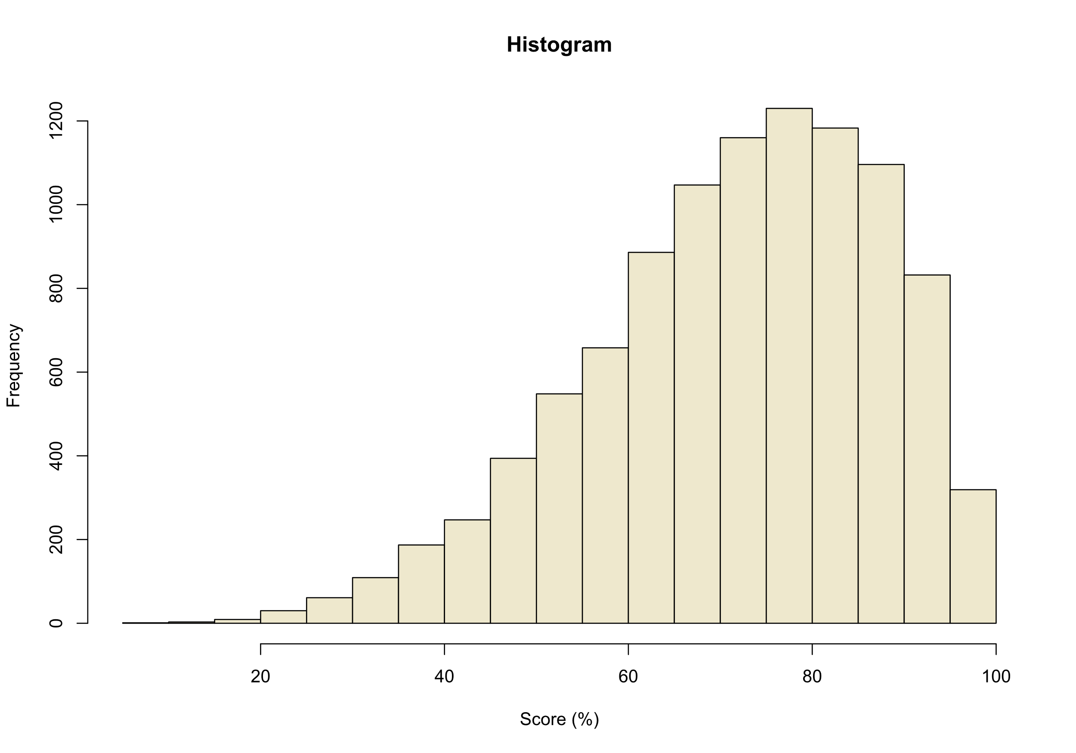
Normal
Skewed- Left Tail
Skewed- Right Tail

Slide 6
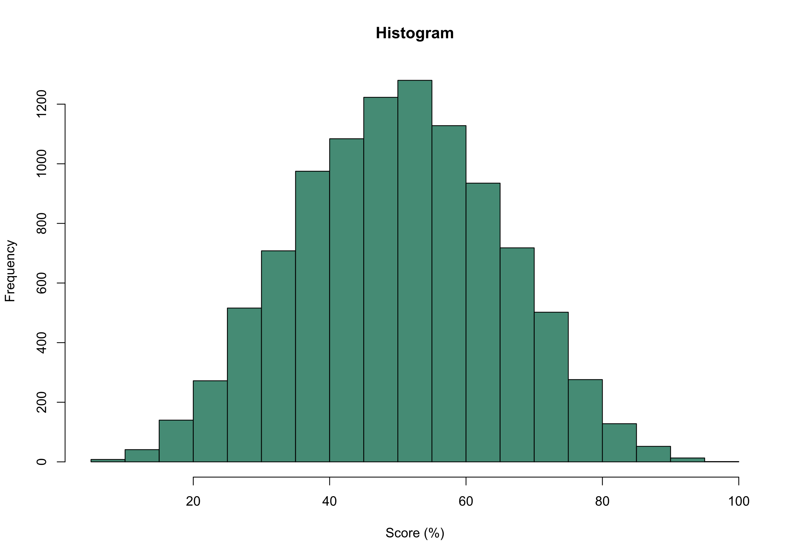
Normal
Skewed- Left Tail
Skewed- Right Tail

Slide 7
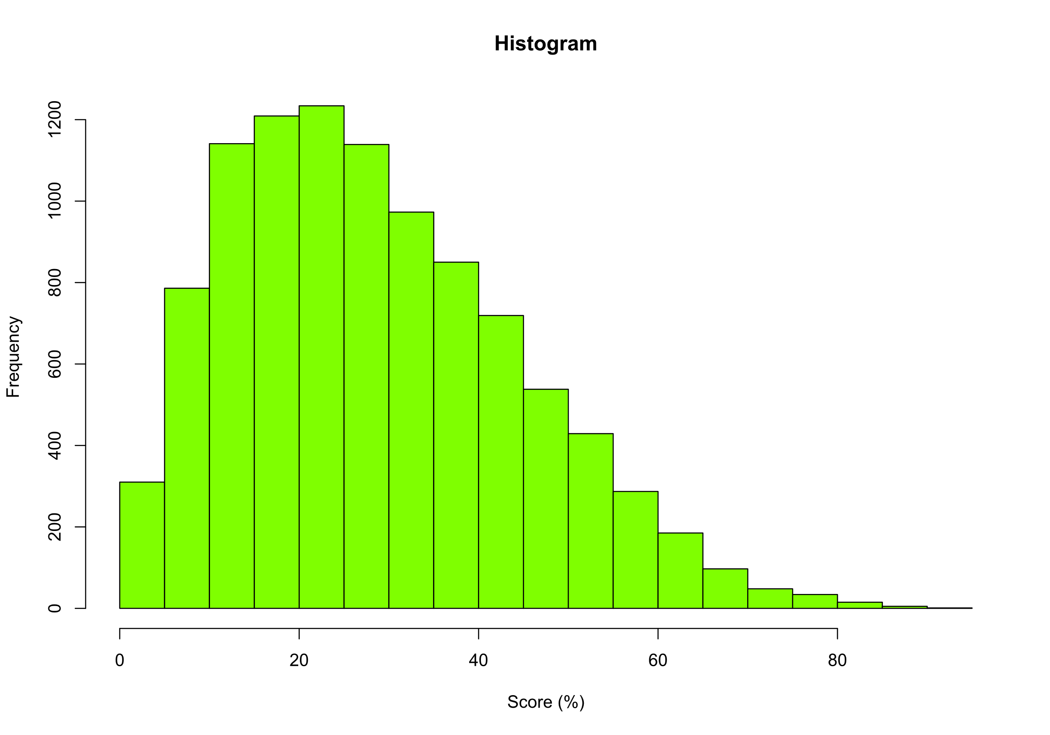
Normal
Skewed- Left Tail
Skewed- Right Tail

Slide 8
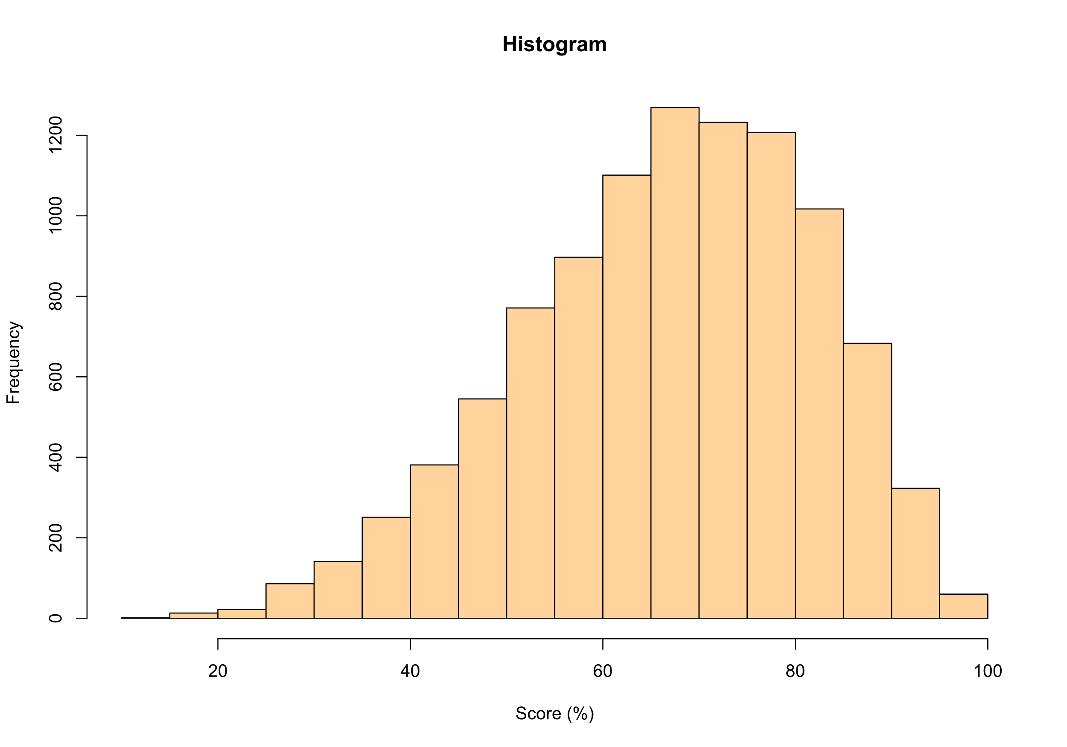
Normal
Skewed- Left Tail
Skewed- Right Tail

Slide 9
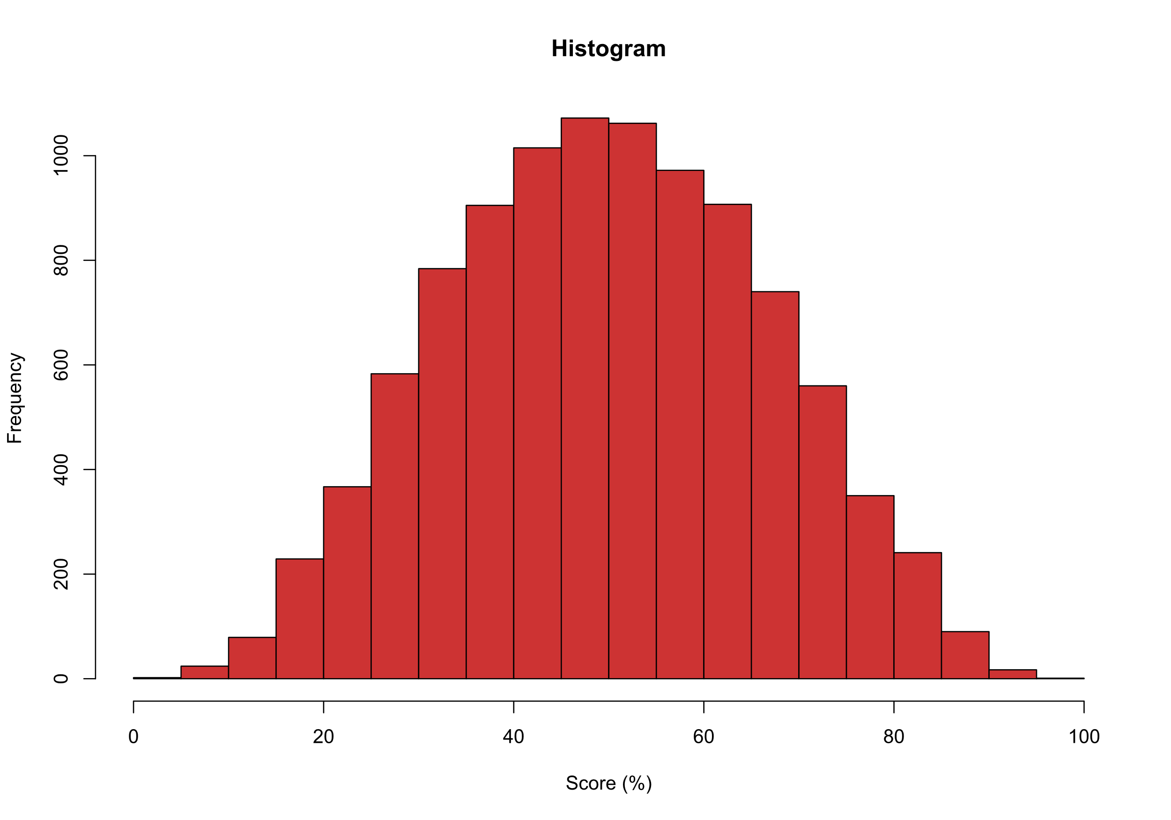
Normal
Skewed- Left Tail
Skewed- Right Tail

Slide 10
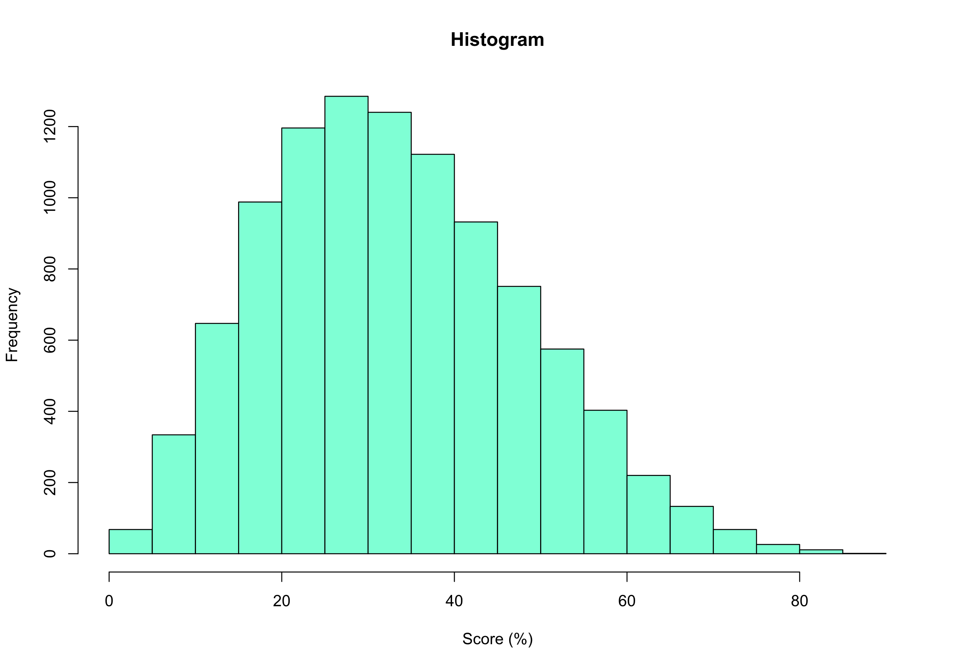
Normal
Skewed- Left Tail
Skewed- Right Tail

Slide 11
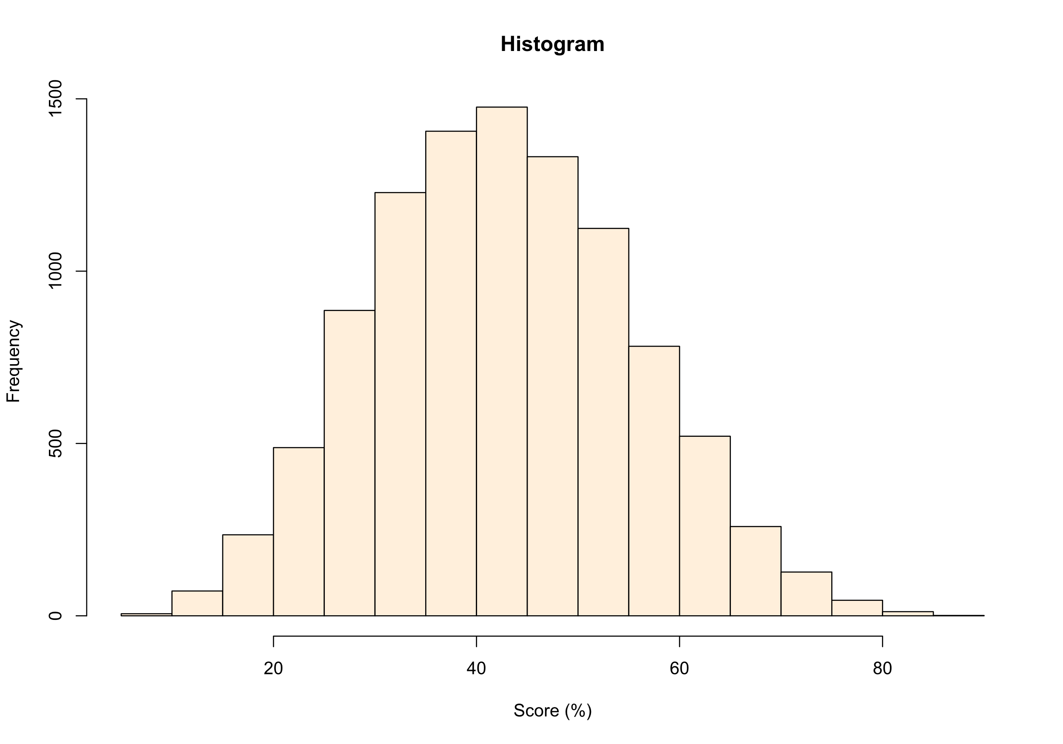
Normal
Skewed- Left Tail
Skewed- Right Tail

Slide 12
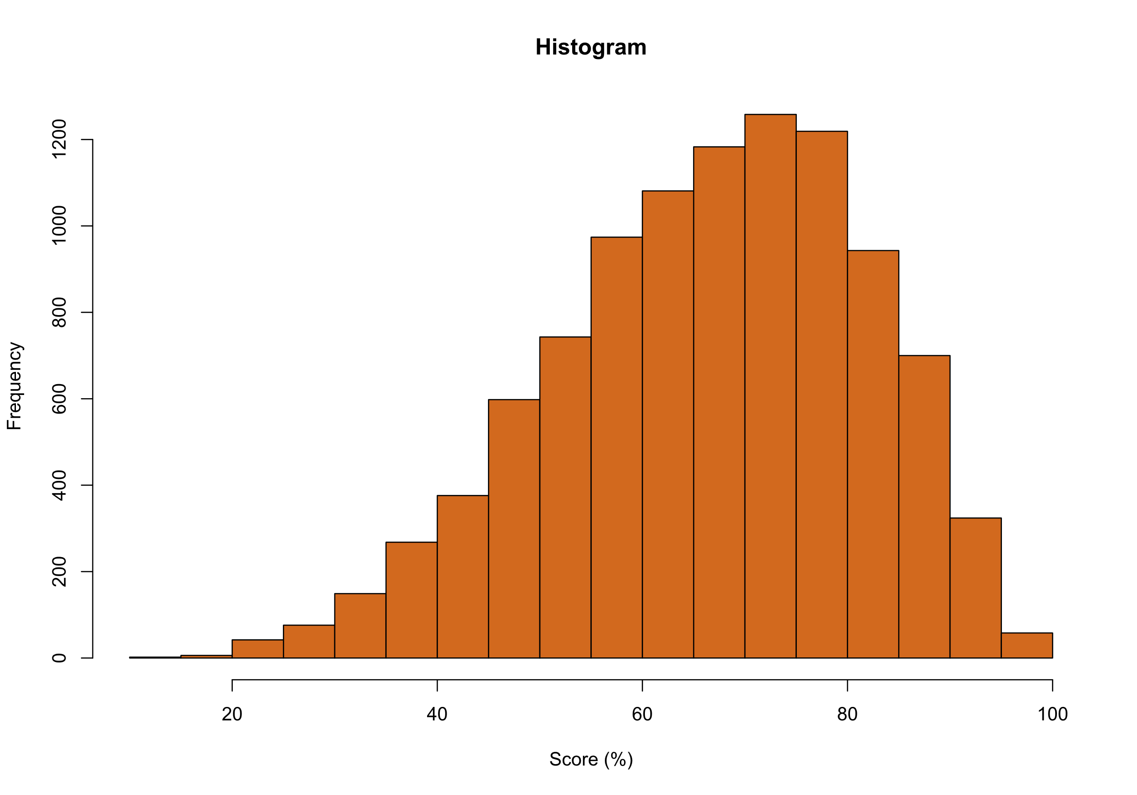
Normal
Skewed- Left Tail
Skewed- Right Tail

Slide 13
Bonus Questions

Slide 14
The decimal point is 1 digit(s) to the right of the |
1 | 24
1 | 555
2 | 00000112222334
2 | 55556788899999
3 | 00001111111222334444
3 | 555666677777888889999999
4 | 000000000000000111122222333334444444
4 | 55555566666666677777777778888999
5 | 00000011111111111112222233333334444444444444
5 | 55666666677778888888999999
6 | 000000011111122223333444444
6 | 556666667777888899
7 | 0011122222223444444
7 | 555567899
8 | 01111223334
8 | 9
Normal
Skewed- Left Tail
Skewed- Right Tail

Slide 15
The decimal point is 1 digit(s) to the right of the |
0 | 3
0 | 778
1 | 00111122222233333334444
1 | 55555555666677777778888888999999
2 | 000000112222223333444444444444
2 | 55555555566666666666777777777788888888889999999999
3 | 00000000011111111222222233333333344444444
3 | 5555555566666677888999
4 | 00000000011111222222233334444
4 | 5666667778888999
5 | 0001222233333344444444444
5 | 55666789999
6 | 001122233344
6 | 58
7 | 0
7 | 8
8 | 2
Normal
Skewed- Left Tail
Skewed- Right Tail

Slide 16
The decimal point is 1 digit(s) to the right of the |
1 | 5
2 |
2 |
3 | 134
3 | 578
4 | 44
4 | 58899
5 | 01233444
5 | 5555666777888899999
6 | 00111111223333334444444
6 | 5555666666666777777788889999999
7 | 00000000111111111223333334444444444
7 | 55555666666667777777777888888888888999999999999
8 | 0001111111112222223333334444444
8 | 55555556666666666667777778888889999999999
9 | 00000000111111111112222222223333334444
9 | 5556666677778
Normal
Skewed- Left Tail
Skewed- Right Tail

Slide 17
ApplyingMaths.com
© Bryn Jones

