Slide 1


Not Your Average Lesson
Bryn Jones
@brynspiration

Slide 2
Session Aims
Why do we use averages?
Mean, mode, median… which should we use?
How do averages link to histograms?
What makes a good statistical task?
Stuff you can use!

Slide 3
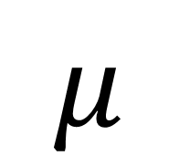
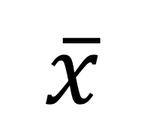
Averages
$$μ$$
$$\overline{x}$$
A fair representation/summary
An estimation of a population
It’s useful to summarise data with just some headline figures.
“The average score on a test was 58%” is more useful than a list of 30 scores.
A sample average acts as an estimate for a population’s average
“In Britain, the average woman is 162.4 cm tall, and the average man is 174.4 cm tall.” When was the list time you were measured?

Slide 4
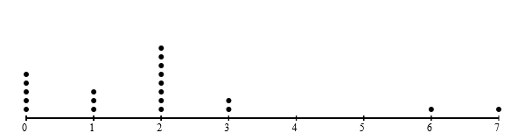
Averages and Dot Plots
Number of dentist visits in a year
N=20

Slide 5
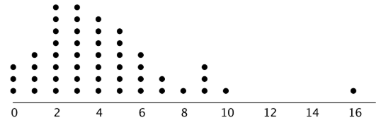
Task 1
Dot Plots

Slide 6
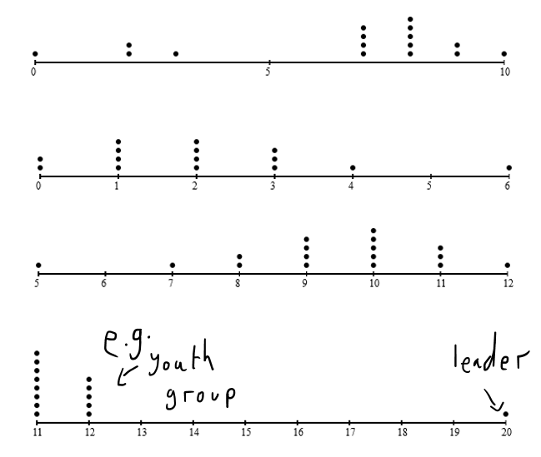

Task 1 Answers

Slide 7

Hands Up!
Do you consider yourself to be a mathematician?
Do you consider yourself to be a statistician?

Slide 8
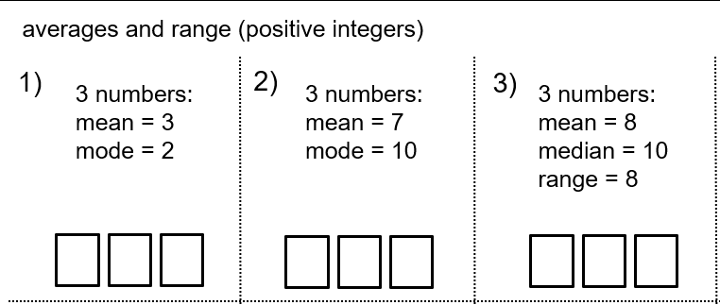
A typical averages task
Notes:
This task comes from the mighty Don Steward.

Slide 9
What makes a good averages task?
Set in a real-life context.
Gets students thinking about which average they are using, rather than merely the calculation.
Encourages thought about whether they are calculating an average, or estimating a population average.
Messy.

Slide 10
Business - Salaries
Apprentices
£19,000
Core Team
£25,000
£25,000
Managers
£45,000
£49,995
Owner
£198,000
£19,000
£28,000
£32,000
£33,000
Join our team! Our average salary is £47,000.

Slide 11
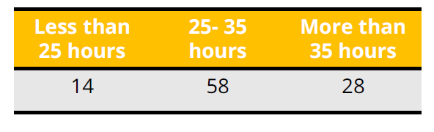
Task 2
Which Average?

Slide 12
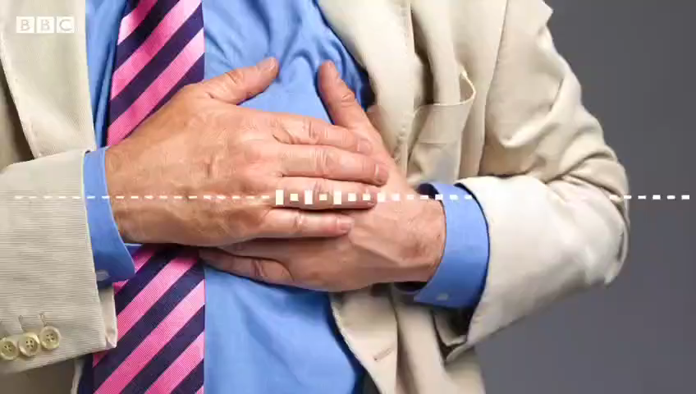
More or Less

Slide 13
More or Less
Questions
Initially, the clip says "the mean average waiting time has always been longer than the median".
Why might that be?
Sketch a dotplot.
Which average is the more appropriate to quote?

Slide 14
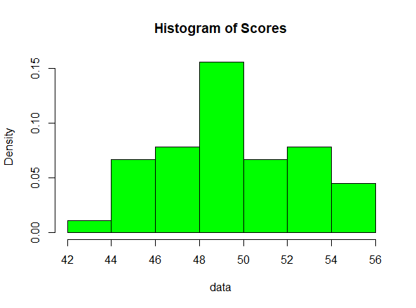
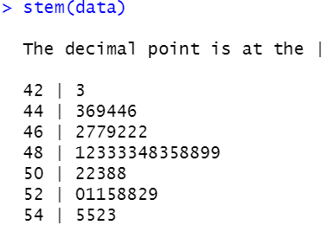
Histograms and Stem-and-Leaf

Slide 15
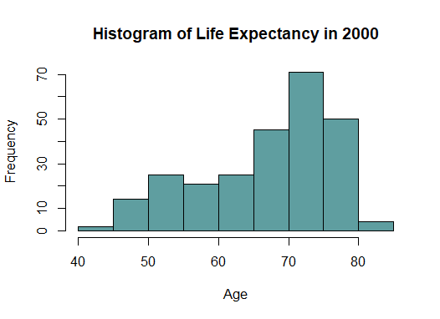
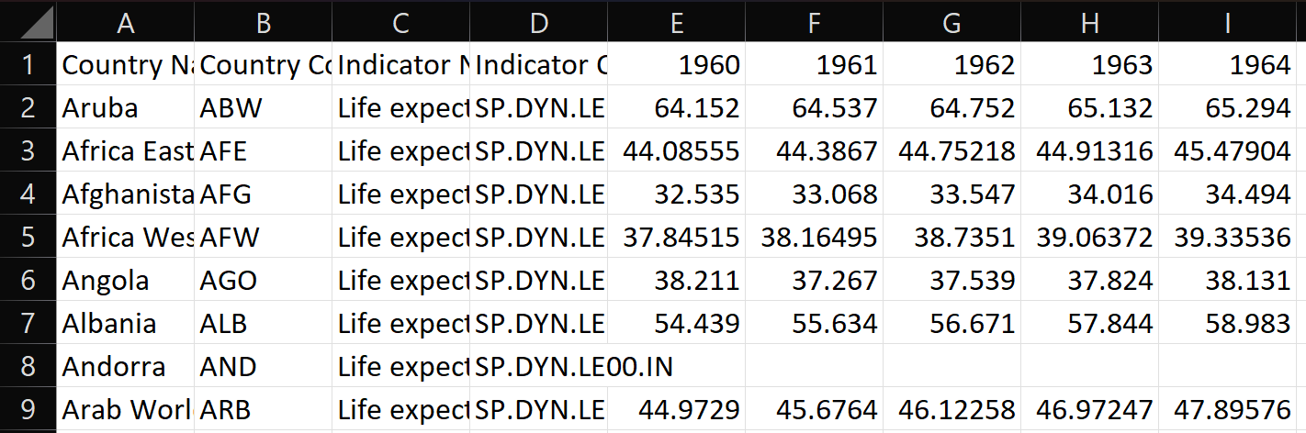
Task 3
Histograms

Slide 16
Core Maths
Be able to select and calculate appropriate measure of central tendency (OCR Spec)
Interpret, analyse and compare the distributions of datasets… through appropriate measures of central tendency. (Edexcel spec)
Calculating/identifying mean, median… and reaching conclusions based on these measures. (AQA spec)

Slide 17
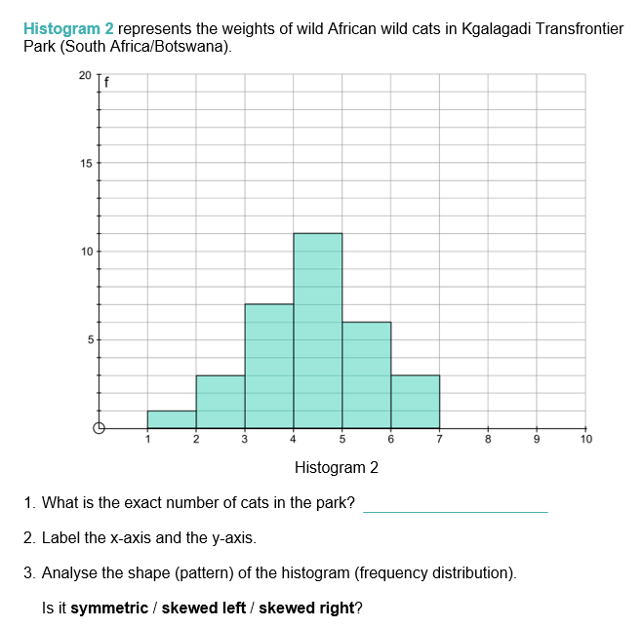
Core Maths
https://www.stem.org.uk/resources/elibrary/resource/76319/skew-histograms
Notes:
Mark the mean, mode and median

Slide 18

Other Fun Tasks
Central Tendency by Don Steward (Students generate data- messy and gets to the question of “which average?”)

Slide 19
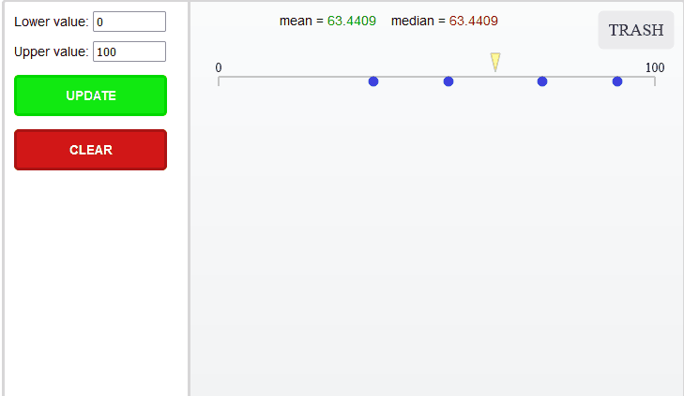
Other Fun Tasks
Interactive App

Slide 20
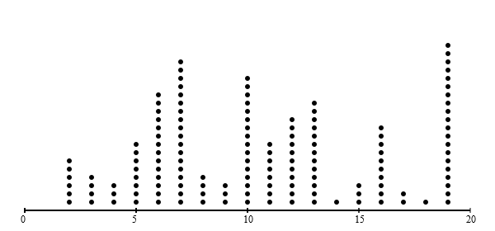
Other Fun Tasks
Dot plot generator

Slide 21
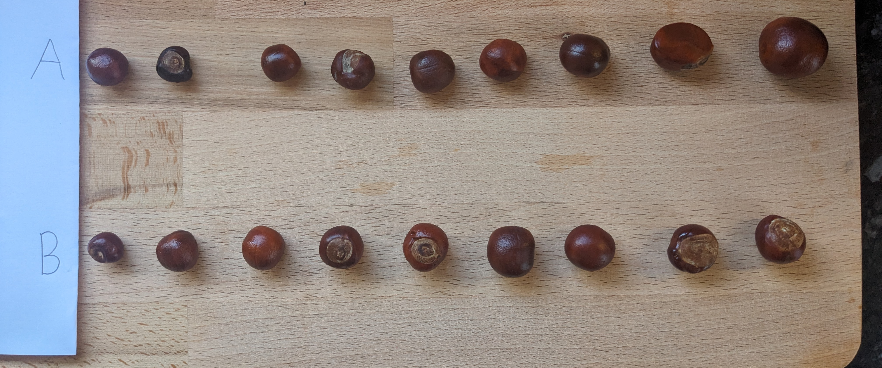
Conkers – A Statistical Prompt

Slide 22
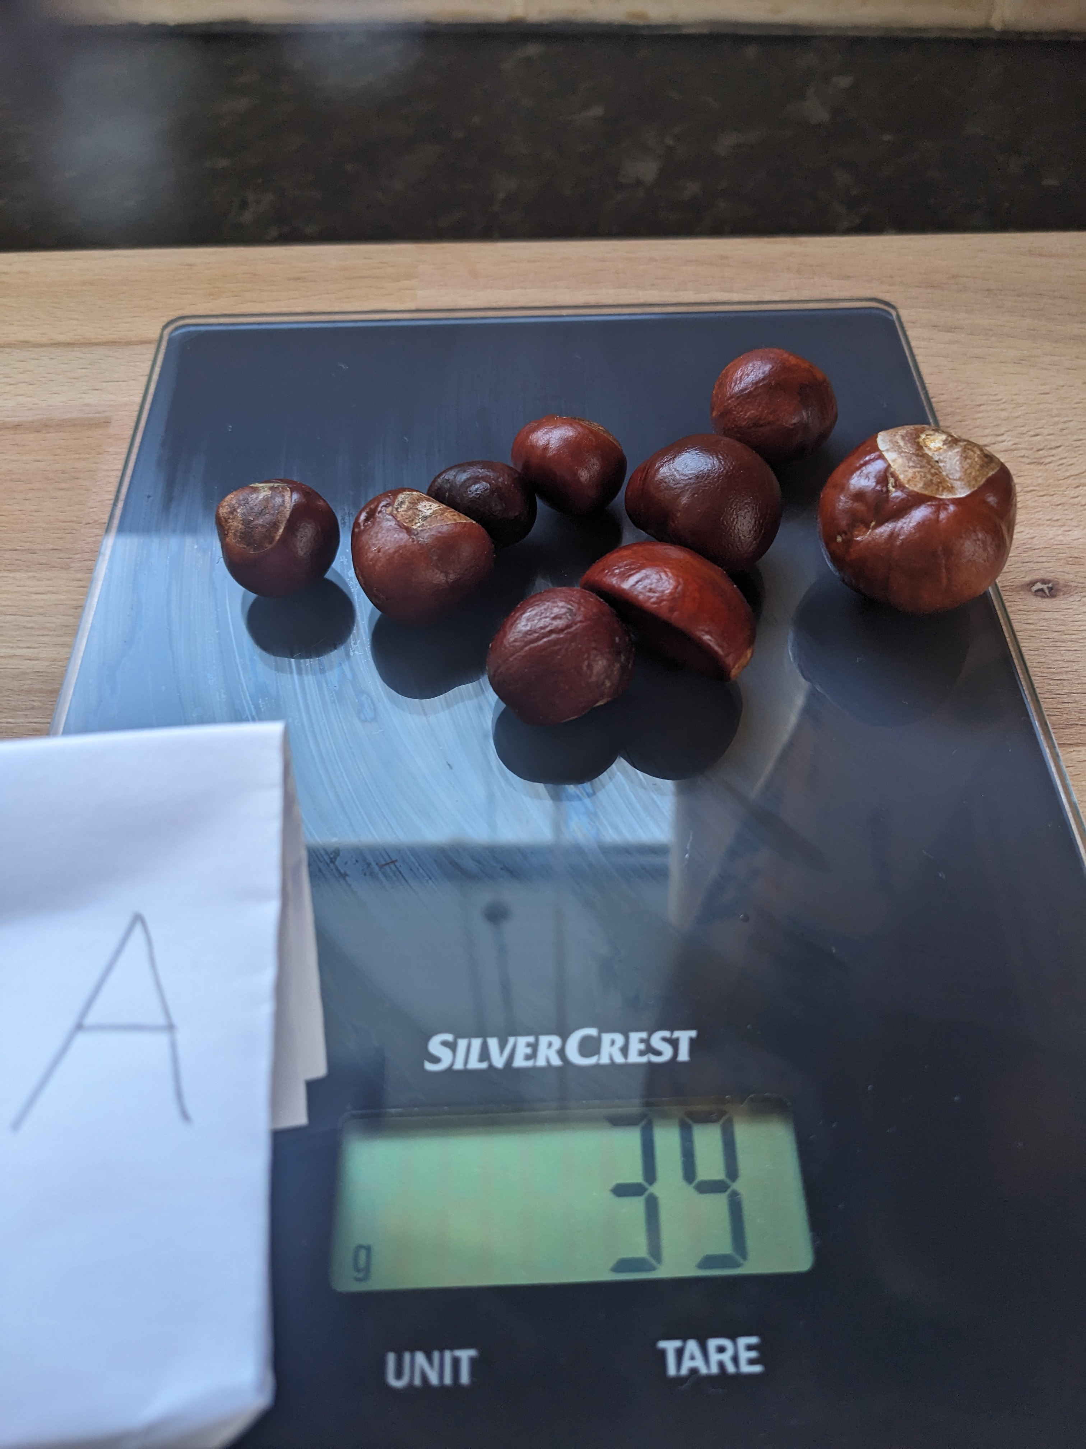
Conkers – A Statistical Prompt

Slide 23
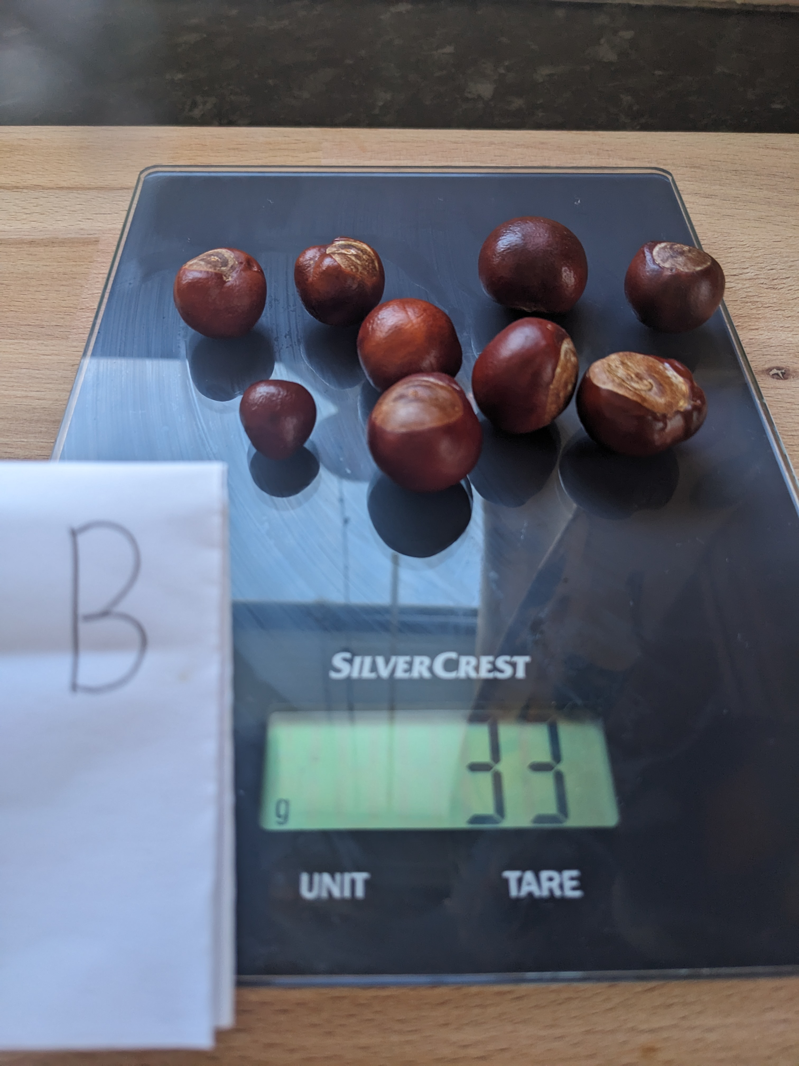
Conkers – A Statistical Prompt

Slide 24
Other Fun Tasks
Conkers
What questions can we ask?
What questions can we answer?
What questions can’t we answer?

Slide 25
Any Questions?

Slide 26
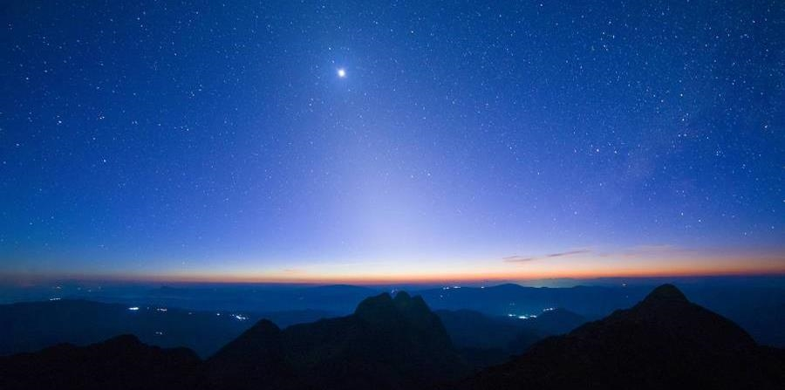

Thank you
Bryn Jones
brynrichardjones@gmail.com
@brynspiration

