Slide 1
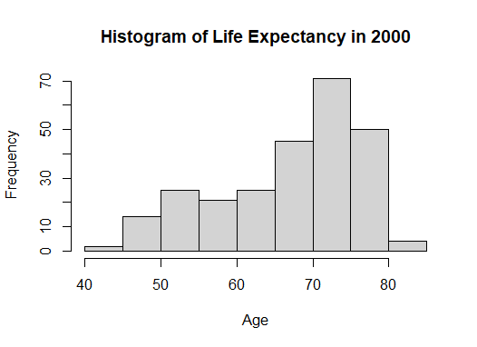
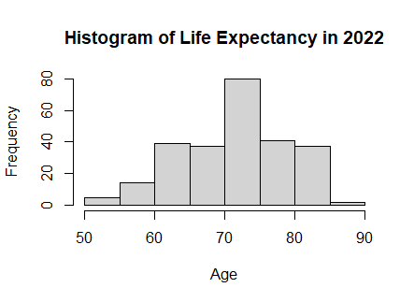
Histograms
Source: the world bank. This dataset contains the average life expectancy for each country over different years.
Questions
State the modal age interval in 2000. Explain in plain English what this means.
Compare how life expectancy has changed between 2000 and 2022. Give as much detail as you can.
For 2000, which is greater: the mean or the median age?
For 2022, which is greater: the mean or the median age?
Q2 For each dot plot, mark where the median value.
Mark also where you estimate the mean to be.
Q3 Which average gives the best representation?

